Slide 1
Species-Specific Data Trends
Air Resource Specialists
Joe Adlhoch
August 27, 2019

Slide 2
Scope of Project
Objective: identify/bound uncertainty in EPA revised tracking metric assumptions of natural contributions and explore implications to the URP glide path
Method: Calculate Theil trends (2000-2017) in components of aerosol extinction and identify which are statistically significant
Display: Add tools to the TSSv2 to allow states to review results
This work has evolved and will continue to based on what states find useful

Slide 3
New (Preliminary) TSS Trends Tool
New tool on the TSS allows you to view species trends at all IMPROVE sites in two ways:
  Comparison of MID, All Days and Clearest Days
  Comparison of Anthropogenic and Natural Components in MID
Greyed out plots indicate trend NOT significant
Data tables for each plot are available

Slide 4
Close up – Comparison of MID, All and Clearest Days

Slide 5
Close up – Comparison of MID by Component

Slide 6
Example 1 – MID vs. All Days, Rocky Mountain
Decreasing trends of differing slopes

Slide 7
Example 2 – Natural Carbon at Sawtooth
Relatively flat Routine Natural and Episodic trends may indicate these are reasonable estimates

Slide 8
Example 3 – Nitrate and Sulfate at Agua Tibia
Steep Nitrate and Sulfate trend lines hit zero before 2030; not likely to happen, but will affect how MID are selected

Slide 9
Example 4 – Carbon at Guadalupe Mountains
Decreasing Anthropogenic but increasing Routine Natural OMC is curious; likely due to shifting of Most Impaired Days selection as other species are reduced

Slide 10
Example 5 – Trends at Glacier
Comparison of Trends from 1989 (green) and 2000 (red) to 2017
Most trends have similar properties
Diverging trends in nitrate due to high values in early 2000s
Diverging trends in coarse mass due to low values in early 2000s

Slide 11
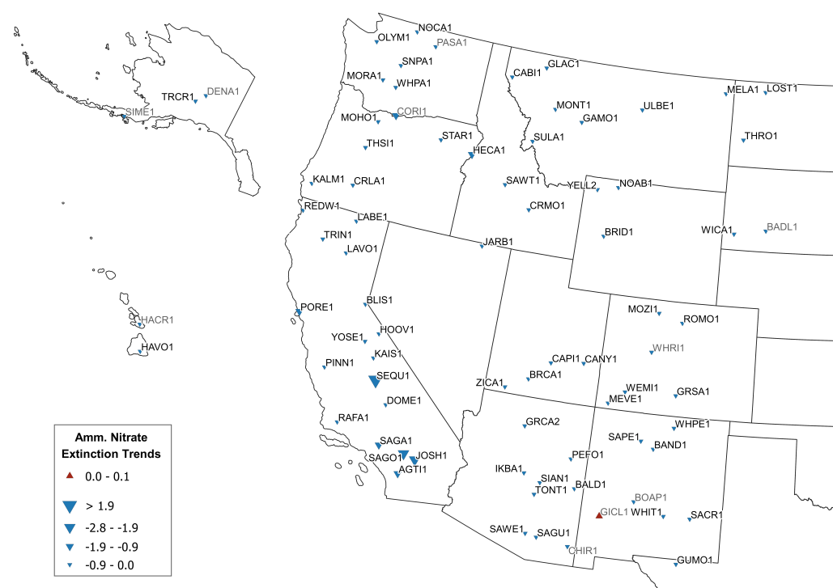
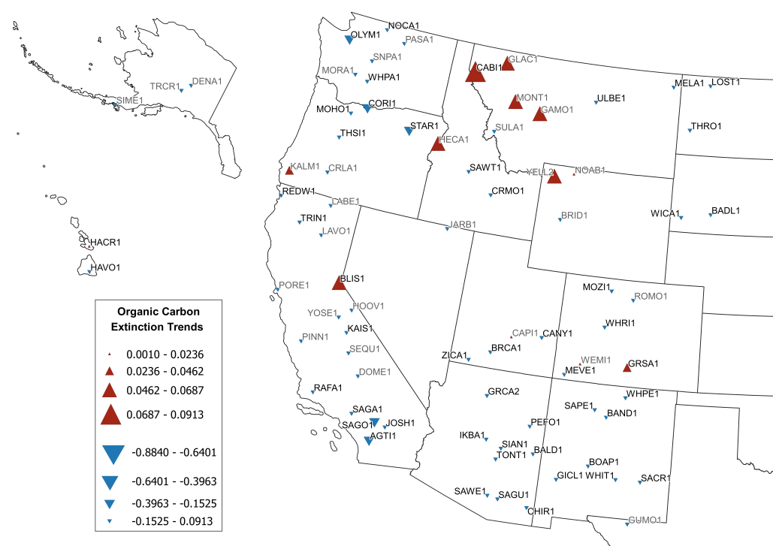
Quick Regional Look at Results

Slide 12
Things to Consider
Where do trends look non-intuitive or surprising?
  How do MID and All Days trends compare?
  Are these caused by non-optimal selection of Episodic events? (See Brandon’s work)
  Are these caused by changes in Anthropogenic impacts that alter which days are selected?
Where do trends cross the x-axis?
  Do we believe these species will reach zero in the next 10 years?
  More likely the future trends will shallow, but how will these changes effect selection of days in the future?
What other perspectives can states bring to this analysis?

Slide 13
Next Steps
Map out all haze components to look for local or regional patterns of interest
Feed back from states – pleases look at your sites and let us know what you find interesting, confusing or useful
ARS – with Tom and the RH Coordination & Glide Path Subcommittee – are happy to investigate specific issues for you

